Slide 1


BES171: Banking, Finance & Insurance
Money Evolution
Monetary Policy
Evolution & Classification of FI
Digital Payment
BASEL, NPA, TBS, Bad Bank-PARA
Finance, Insurance & Fin.

Slide 2
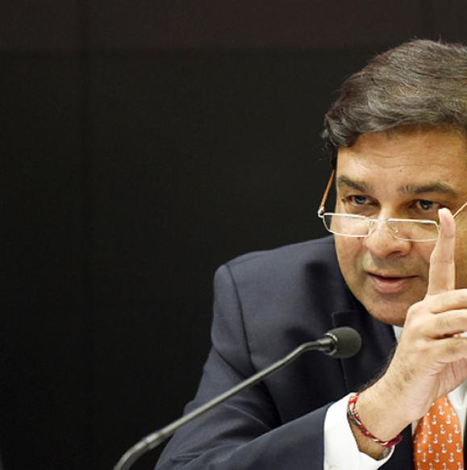
Monetary Policy: Tools
Volume of credit
Quantitative/Gen./Indirect
Qualitative: Selective, Direct
Reserve Ratios (CRR, SLR)
OMO & MSS
Rates: Bank, MSF, LAF [Repo, RR]
Selective Credit Control (SCC), PSL, Credit Rationing
Moral Suasion
Direct Action
+review of last one year’s policies
Consumer Credit control / EMI
Margin / LTV
Distribution of credit
…Then limitation of MP &
Mains Answer Writing Practice

Slide 3


WHY SELECTIVE CREDIT CONTROL?
Nationalization
‘69 (14 banks)
‘80 (6 banks)

Slide 4






Selective credit control : “Distribution” of credit [qunt- “volume” of credit]
Selective credit control
Negative, Restrictive
Positive
Priority sector + “rationing” (min. this much)
“Ceiling” in “Non-Food” sector
Ceiling to “big loans”
Consumer credit control for durables

Slide 5

Making loans expensive or unavailable to non-priority sector
SCC: NEGATIVE
method
1965-89: Credit Authorization Scheme (CAS) all commercial banks had to obtain prior approval of the RBI before giving Rs. 1 crore/> to a single borrower. [long delays in approval, lax monitoring]
1970: fixed higher interest for loans for sensitive commodities.
1973: quantitative ceiling on non-food loans (to boost green revolution, food inflation)
Notes:
1956: Selective credit control (SCC) & LTV first time used.
e.g. 20% for cotton.

Slide 6
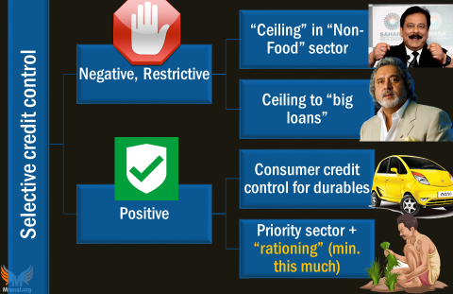
Used pre-LPG era, but mostly ineffective, why?
Have been used to combat inflation in cotton, sugar, oilseeds, oil and metals. But Supply side constrains + SCC = more inflation since genuine trader can’t buy!
Speculative traders used Black money and non-bank finance for commodity hoarding.
+lax monitoring and loopholes

Slide 7
Selective credit control : “Distribution” of credit [qunt- “volume” of credit]
Selective credit control
Negative, Restrictive
Positive
Priority sector + “rationing” (min. this much)
“Ceiling” in “Non-Food” sector
Ceiling to “big loans”
Consumer credit control for durables

Slide 8
Why PSL?
Priority sector (40%)
Corporates (40%)
Home, Education loans
Backward, Minorities
Middleclass (20%)
Agri, SME
Post-LPG

Slide 9
Why industrialists were getting so much loans till late-60s?
Directorship & Suitcase Raj
1963: 188 people were in board of top 20 banks, 1452 companies
FYP & PSUs & license raj
FYP: heavy industries-> PSU -> but raw material, machineries still from private industrialists
Private industrialists-> loans; later PSUs themselves getting
Had to break cycle because
Late 60s: Green revolution: HYV, fertilizer, inputs: farmers needed loans
But Cooperative societies insufficient. RRBs yet to come (1976); Hence PSL first time mentioned in 1968…..
1967: Morarji (FM)- “Social control over bank”- BoD people with social economy, rural Development, restriction on lending to directors.. [banking law];
‘69 and 80 nationalized: political favoritism & suitcase raj: Unviable “greenfield” project-> Suitcase raj + political consideration-> license -> loans

Slide 10

Priority sector lending
Qualitative tools
1968: first time RBI used the word “priority sector” 1) agri 2) small industries 3) exports….target 40% by 1985.
1969: nationalization round#1 (14)
1971: Credit Guarantee Corporation of India Ltd. established. To facilitate bank lending to the priority sectors.
1980: Bankers to give more loans to Indira’s 20-Point program for removing poverty & reviving economy
Years and chronology not important for Prelims but for GSM1 Post-independence economy, you should know key terms
Notes:
1967: National credit council under RBI-> agri. Credit board (1970)
PM Indira Gandhi, in a radio broadcast, announced measures to revive the economy and reinforce her image as a leader with socialist leanings. Among the announcements were: raising the income tax exemption limit to Rs 8,000 from Rs 6,000, confiscation of properties owned by smugglers, ceilings on ownership and possession of vacant land, and acquisition of excess land. Land ceiling laws would be strictly implemented and surplus land distributed among rural poor. The 20-point programme included steps to bring down prices of essential commodities, promote austerity in government spending, crack down on bonded labour, liquidate rural indebtedness and make laws for a moratorium on recovery of debt from landless labourers, small farmers and artisans.
Just and necessary Indira Gandhi defended the imposition of Emergency at a meeting of the Congress Parliamentary Party executive, claiming that various organisations had been planning to conduct widespread sabotage. Leaders, including party chief D.K. Baruah, Jagjivan Ram, C. Subramaniam, Swaran Singh and Y.B. Chavan attended the meeting, where the consensus was that the Emergency was justified and necessary.
Phizo for talks A Shillong datelined report said that Naga rebel leader A.Z. Phizo, at that time living in exile in England, had directed his lieutenants in Nagaland to pave the way for an “honourable settlement” of the “Naga problem”.
Amin pardons Hills Ending a diplomatic stalemate, Ugandan President Idi Amin said he had decided to pardon British academic and writer Denis Hills, who had been sentenced to death. Hills, 61, was to be executed later in the week for calling Amin a village tyrant in an unpublished manuscript.

Slide 11
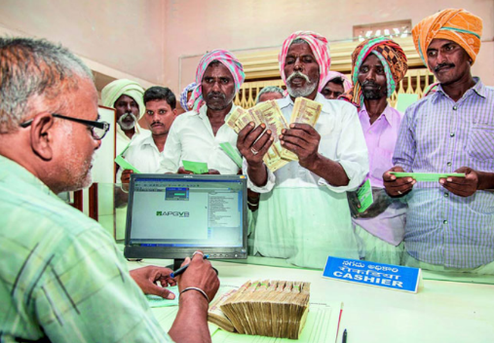

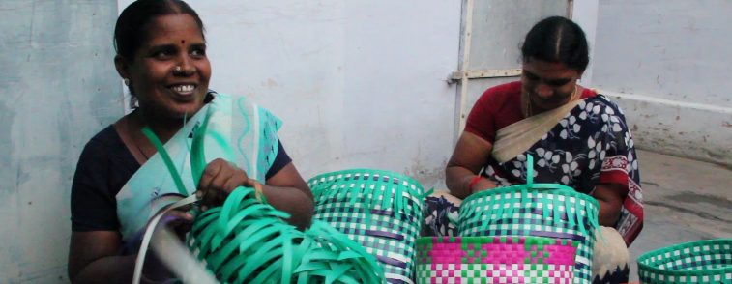

Priority Sector Lending (PSL)

Slide 12
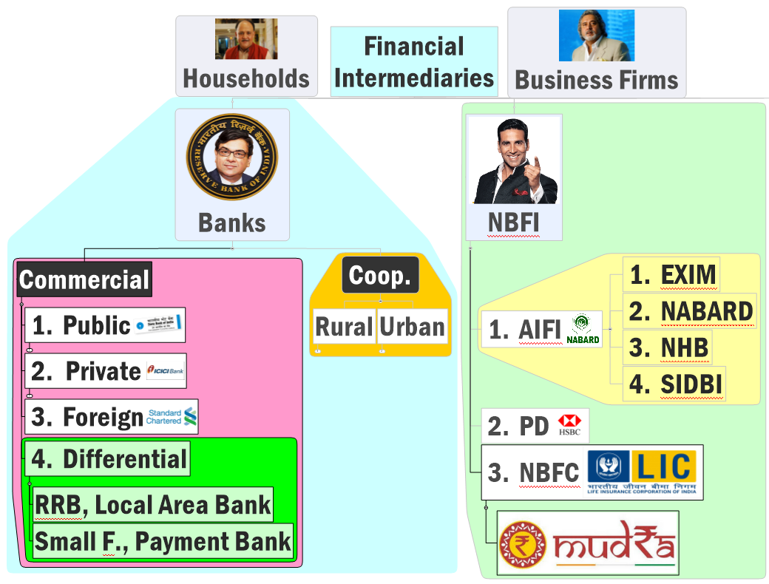

PSL applies to whom?
40%
40%
40%
40%
75%
75%
Can’t loan, so doesn’t apply.

Slide 13
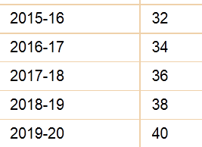

April 2015: PSL norms revised
SCB | Foreign Banks 20/> branches
uSCB 40% | (RRB & SFB:75%)
Foreign Banks banks <20 branches
40% But in phased manner
Adjusted net bank credit OR
Off balance sheet exposure
Whichever is high
Notes:
Reserve Bank of India (RBI) on Thursday revised the priority sector lending target for regional rural banks (RRBs) to 75% of total outstanding loans from 60% earlier, effective January 2016.
The central bank said that data on priority sector advances has to be furnished by RRBs to Nabard at quarterly and annual intervals. “For the purpose of calculation of priority sector lending targets, total outstanding will be calculated as on corresponding date of the previous year,” it added.

Slide 14


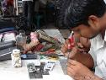
New PSL:WEF 1/4/15; *=new cat.; Loan given to MFI also counts
Category | % SCB loans
Weaker Sections | 10%
Agri | 10%
*Marginal Farmer (upto 1ht) *Small farmer (>1 upto 2ht) | 8%
Micro Enterprises Khadi-Village indu. | 7.50%
All PSL categories | 4.5%
Total PSL | 40%
Notes:
After reviewing in 2017 they’ll do post-2018
Total Priority Sector Target within a maximum period of five years starting from April 1, 2013 and ending on March 31, 2018 as per the action plans submitted by them and approved by RBI.

Slide 15



New PSL:WEF 1/4/15; *=new cat.; Loan given to MFI also counts
Category | % SCB | FB with 20/>+
Weaker Sections | 10% | Mar. 2018
Agri | 10% | Mar. 2018
*Marginal Farmer (upto 1ht) *Small farmer (>1 upto 2ht) | 8% | Post-2018
Micro Enterprises Khadi-Village indu. | 7.50% | Post-2018
All PSL categories | 4.5% | --
Total PSL | 40% | Mar.2018
Notes:
After reviewing in 2017 they’ll do post-2018
Total Priority Sector Target within a maximum period of five years starting from April 1, 2013 and ending on March 31, 2018 as per the action plans submitted by them and approved by RBI.

Slide 16
New PSL:WEF 1/4/15; *=new cat.; Loan given to MFI also counts
Category | % SCB | FB with 20/>+ | FB <20
Weaker Sections | 10% | Mar. 2018 | NA
Agri | 10% | Mar. 2018 | NA
*Marginal Farmer (upto 1ht) *Small farmer (>1 upto 2ht) | 8% | Post-2018 | NA
Micro Enterprises Khadi-Village indu. | 7.50% | Post-2018 | NA
All PSL categories | 4.5% | -- | Upto 32% in export units upto Rs.100 cr. turnover
Total PSL | 40% | Mar.2018 | 40% by 31/3/2020
Notes:
After reviewing in 2017 they’ll do post-2018
Total Priority Sector Target within a maximum period of five years starting from April 1, 2013 and ending on March 31, 2018 as per the action plans submitted by them and approved by RBI.

Slide 17
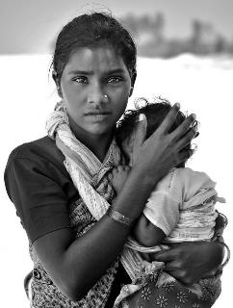
PSL Definition:10% loans should goto Weaker section
Qualitative tools
Small, Marginal, Distressed Farmers
Women upto Rs. 1 lakh per borrower
SC, ST, PH and minorities
Artisan, Cottage/Village industry- upto Rs.1L
NRLM/NULM Beneficiaries;
Rehabilitee Manual Scavengers
PMJDY overdraft upto Rs.5k : provided household annual income does not exceed ₹ 100,000/- for rural areas and ₹ 1,60,000/- for non-rural areas

Slide 18


PSL Definitions of MSME industry
Mfg. (plant-machine investment)
Micro: upto 25 lakh
Small: >25l-5cr.
Medium:>5-10cr
Service (equipment investment)
Micro: upto 10 lakh
Small: >10l-2cr.
Medium:>2-5cr
All eligible, but special quota of 7.5% for Micro enterprises & Khadi-Village industries
Area <10k population
Investment<15k / worker

Slide 19
PSL: other categories [** new cat.] Technical Details
Agri
Rs.20 lakh out of Rs.25 lakh home in other areas
Rs. 28 lakh out of Rs. 35 lakh home In Metro (10Lakh/>)
Home repairs, slum rehab etc. eligible with similar caveats
Export credit
100 cr. Turnover
Max. 2% for SCB and FB(20/>Branches)
Housing
Apart from farmers/KCC; Soil conservation, watershed
Vermi compost, bioferti/pesti; seed production (but max Rs.100 cr)
Cooperative societies, food processing, PACS, MFI, RIDF (NABAD)
Notes:
Existing: housing / edu. Loans, export credit
New categories Medium enterprises, social infra and renewable energy.
Separate PSL target for small / marginal farmers, micro enterprises.
no distinction in direct / indirect lending to agro.
More details: on individual categories and quantitative limits- visit https://rbi.org.in/Scripts/NotificationUser.aspx?Id=9688&Mode=0

Slide 20
PSL: other categories [** new cat.] Technical Details
** Social Infrastructure (in T2 to T4 centers)
schools, health care facilities,
**Renewable Energy
upto ₹ 15 crore to solar/biomass generators, wind mills, micro-hydel plants; non-conventional energy for street lights, remote village
drinking water facilities and sanitation facilities
upto ₹ 10 lakh for individual household
Education Loans
Upto Rs.10 lakh
Notes:
Existing: housing / edu. Loans, export credit
New categories Medium enterprises, social infra and renewable energy.
Separate PSL target for small / marginal farmers, micro enterprises.
no distinction in direct / indirect lending to agro.
More details: on individual categories and quantitative limits- visit https://rbi.org.in/Scripts/NotificationUser.aspx?Id=9688&Mode=0

Slide 21
New PSL:WEF 1/4/15; *=new cat.; Loan given to MFI also counts
Category | % SCB loans
Weaker Sections | 10%
Agri | 10%
*Marginal Farmer (upto 1ht) *Small farmer (>1 upto 2ht) | 8%
Micro Enterprises Khadi-Village indu. | 7.50%
All PSL categories | 4.5%
Total PSL | 40%
RRB & SFB:75%
Notes:
After reviewing in 2017 they’ll do post-2018
Total Priority Sector Target within a maximum period of five years starting from April 1, 2013 and ending on March 31, 2018 as per the action plans submitted by them and approved by RBI.

Slide 22

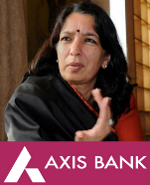

PSL: What if targets not met?
Desi (+Foreign 20/>) | Foreign bank <20
Remaining $$ to RIDF | To SEDF
Rural infra. Development fund | small enterprises development fund
NABARD manages | SIDBI manages
NABARD pays interest & principal to the bank | Same by SIDBI
State governments get infra. Loan | Similar case: state industrial fin.corp.

Slide 23
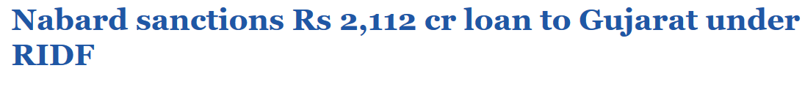
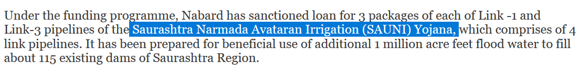
TheHindu, October 2015
Gujarat: sending Narmada Water
West (Saurashtra: Rajkot, Jamnagar, Morbi)
SAUNI- 2016 Modi inaugurated
North (BK, Arvalli, Patan)
Sujalam Sufalam- 2007

Slide 24
PSL: What if targets not met?
Desi (+Foreign 20/>) | Foreign bank <20
Remaining $$ to RIDF | To SEDF
Rural infra. Development fund | small enterprises development fund
NABARD manages | SIDBI manages
NABARD pays interest & principal to the bank | Same by SIDBI
State governments get infra. Loan | Similar case: state industrial fin.corp.

Slide 25

Why PSL lending certificates?
Category | % SCB loans
Weaker Sections | 10%
Agri | 10%
*Marginal Farmer (upto 1ht) *Small farmer (>1 upto 2ht) | 8%
Micro Enterprises Khadi-Village indu. | 7.50%
All PSL categories | 4.5%
Total PSL | 40%
Our rural presence is low, how can we accomplish these internal quotas?
RIDF: principal stuck for long term
Notes:
After reviewing in 2017 they’ll do post-2018
Total Priority Sector Target within a maximum period of five years starting from April 1, 2013 and ending on March 31, 2018 as per the action plans submitted by them and approved by RBI.

Slide 26






Priority sector lending certificate (2016,Apr) technical here
RG “humse PSL-Quota karid-lo YOJANA”
RBI E-Kuber
Credit Risk
Assets
Cash flow
20 cr. loan
16 cr. loan
18 cr. loan
18 cr. loan
Short term accounting instrument (expire @FY)
Min. pack 25 lakh x 8=2 Cr.
Seller fee (Market determined; will be counted as “Misc. income of the seller bank)
Suppose in PSL- each bank had to give 18 cr. Each to farmers?
Notes:
The PSLC is a short-term accounting instrument
Expire on 31st March each year
Pack of Rs.25 lakh/>
Buy an sell to cover shortfall, through RBI's e-kuber platform
Fees market determined- and counted as "Misc. Income" / "Expenses"
No credit risk/assets/Cash flow transferred.
More details

Slide 27
Priority sector lending certificate
Four types
Four Players:
SCB
RRB [75% PSL]
Small Finance Banks [75% PSL]
PSL-Agri
PSL-S/M Farmer
PSL-Micro enterprises
PSL-Overall
Local Area Banks
RBI E-Kuber

Slide 28
Selective credit control : “Distribution” of credit
Selective credit control
Negative, Restrictive
Positive
Priority sector + “rationing” (min. this much)
“Ceiling” in “Non-Food” sector
Ceiling to “big loans”
Consumer credit control for durables
In “rationing”..if “subsidy” given then fiscal policy starts to overlap

Slide 29
Credit “Rationing” fiscal policy encroaches on monetary policy
Qualitative tools
1968: Export credit interest subsidy
1972: Differential interest rate scheme in PSB: for low income groups
2006: Interest subvention scheme for farmers (7-3=4%)
2016: Interest subvention Home loans (post-demonetization)
Notes:
1967: National credit council under RBI-> agri. Credit board (1970)
PM Indira Gandhi, in a radio broadcast, announced measures to revive the economy and reinforce her image as a leader with socialist leanings. Among the announcements were: raising the income tax exemption limit to Rs 8,000 from Rs 6,000, confiscation of properties owned by smugglers, ceilings on ownership and possession of vacant land, and acquisition of excess land. Land ceiling laws would be strictly implemented and surplus land distributed among rural poor. The 20-point programme included steps to bring down prices of essential commodities, promote austerity in government spending, crack down on bonded labour, liquidate rural indebtedness and make laws for a moratorium on recovery of debt from landless labourers, small farmers and artisans.
Just and necessary Indira Gandhi defended the imposition of Emergency at a meeting of the Congress Parliamentary Party executive, claiming that various organisations had been planning to conduct widespread sabotage. Leaders, including party chief D.K. Baruah, Jagjivan Ram, C. Subramaniam, Swaran Singh and Y.B. Chavan attended the meeting, where the consensus was that the Emergency was justified and necessary.
Phizo for talks A Shillong datelined report said that Naga rebel leader A.Z. Phizo, at that time living in exile in England, had directed his lieutenants in Nagaland to pave the way for an “honourable settlement” of the “Naga problem”.
Amin pardons Hills Ending a diplomatic stalemate, Ugandan President Idi Amin said he had decided to pardon British academic and writer Denis Hills, who had been sentenced to death. Hills, 61, was to be executed later in the week for calling Amin a village tyrant in an unpublished manuscript.

Slide 30


Interest Subvention scheme (ISS)
Agriculture (2006)
@PSB, Pvt-SCB, RRB, Cooperative Banks
Housing Post demonetization?
Crop loans upto 3 Lakh &7%
Interest Subvention:- 2%
If regular repayment:- 1%
Farmer’s Effective interest rate: 7-2-1=4%
Demonetization: 60 days interest waiver for agri loans in PACS & Central Cooperatives
Loan upto
2 lakhs
9 lakhs
12 lakhs
Subvention
2%
4%
3%

Slide 31
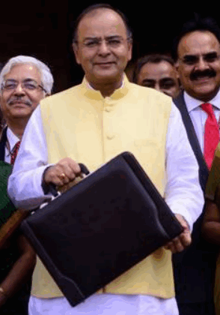
Agriculture loan targets: “Incrementalism”
11% jump
Why agri not growing more than 4%PA?
If this much loans are given then why farmer suicide?

Slide 32

Big farmers near urban areas getting most loans
40% PSL
10% agri
8% S/M
State
PACS
District “Central”
CBS
75%
Dominant caste, political groups cornering

Slide 33
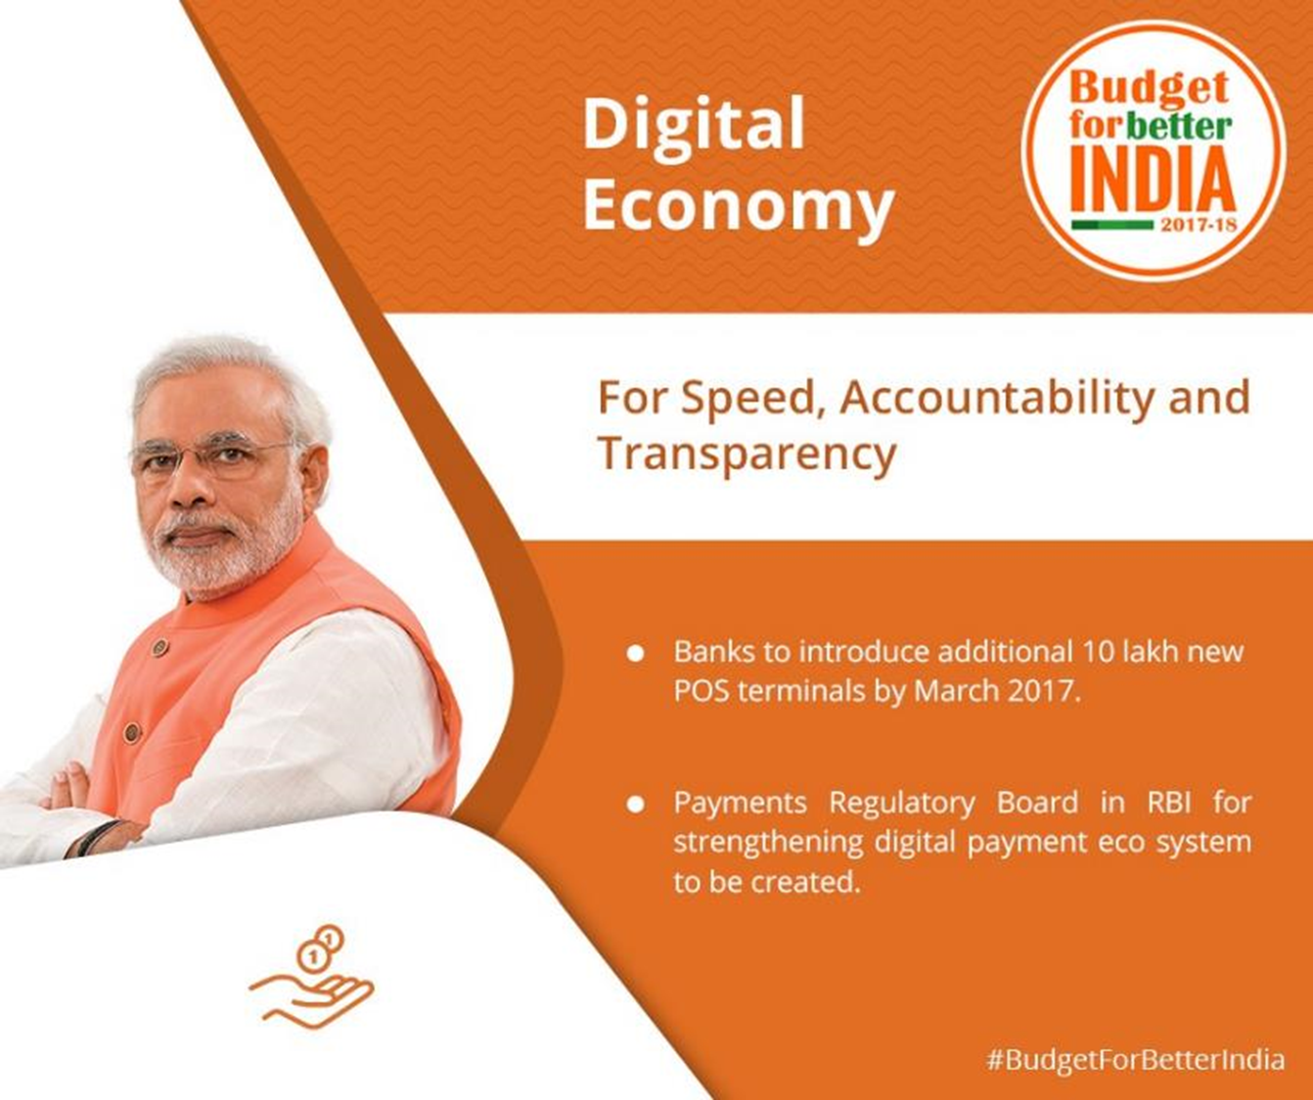
Core Banking Solution (CBS)
PACS-> DCCB.
NABARD given ~1900 cr and 3 years deadline
JDY: Monitoring, money laundering …
Farm loans, aadhar-seeding

Slide 34

Agri PSL: Criticism and reforms
Examine critically?
Criticize
Not reaching small-marginal farmers
2015: RBI: internal quota-10% for agri+ 8% for small-marginal [moneylender-suicide]
2017: Budget- CBS for PACS-Central Cooperatives; 1900 cr. To NABARD= effective monitoring.
March Rush (Annual reporting of PSL)
Farm Loans sanctioned rapidly in Q4, but farmers don’t need it..so spent in social events, pilgrimage, house repairing, vehicle /mobile purchase etc. [SUICIDE]
2015: Quarterly reporting.
Notes:
(x) The priority sector non-achievement will be assessed on quarterly average basis at the end of the respective year from 2016-17 onwards, instead of annual basis as at present.

Slide 35
Agri PSL: Criticism and reforms
Examine critically?
Interest subvention Scheme (ISS)
Farmer getting loans @4%, doing FD @7%= profit of 3% without kheti!
RBI’s Deepak Mohanti Committee on Fin inclusion (2015): remove ISS, give universal crop insurance subsidy…but not done.
Loan waivers, interest waiver
Bad for Repayment habit; In NPA lecture-segment.

Slide 36
Monetary Policy: Tools
Volume of credit
Quantitative/Gen./Indirect
Qualitative: Selective, Direct
Reserve Ratios (CRR, SLR)
OMO & MSS
Rates: Bank, MSF, LAF [Repo, RR]
Selective Credit Control (SCC), PSL: Credit Rationing, Subsidy [fiscal policy]
Moral Suasion
Direct Action
+review of last one year’s policies
Consumer Credit control / EMI
Margin / LTV
Distribution of credit
…Then limitation of MP &
Mains Answer Writing Practice

Slide 37
Selective credit control : “Distribution” of credit [qunt- “volume” of credit]
Selective credit control
Negative, Restrictive
Positive
Priority sector + “rationing” (min. this much)
“Ceiling” in “Non-Food” sector
Ceiling to “big loans”
Consumer credit control for durables

Slide 38

Consumer credit control: to boost automobile demand & sales.
Tight (inflation)
30%
10,000
Easy (Deflation)
Consumer credit
down payment
10%
Min. installment
1,000

Slide 39
Monetary Policy [Red: qualitative tools]
Combat
CRR/SLR
▼
Inflation
Deflation
Money?
Tight / Dear
Easy / Cheap
▲
Policy Rate (Repo Rate)
▲ (hike)
▼
OMO|MSS*
Sell
Buy|NA*
Money supply
▼
▲
CCC
▲ (Tight)
▼ (easy EMI, DownPay)

Slide 40
Monetary Policy: Tools
Volume of credit
Quantitative/Gen./Indirect
Qualitative: Selective, Direct
Reserve Ratios (CRR, SLR)
OMO & MSS
Rates: Bank, MSF, LAF [Repo, RR]
Selective Credit Control (SCC), PSL: Credit Rationing, Subsidy [fiscal policy]
Moral Suasion
Direct Action
+review of last one year’s policies
Consumer Credit control / EMI
Margin / LTV
Distribution of credit
…Then
Mains Answer Writing Practice

Slide 41
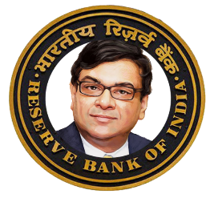
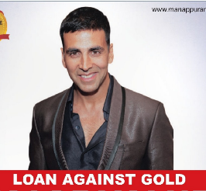



Loan to Value / margin requirements ratio 60%
Loan Customer
Gold worth Rs. 1 Lakh
LTV:
60%
Lends Rs.60,000 only
Loans against Securities (shares/bonds-debentures)
Recession=> 60%=>80%
Selective, Direct.

Slide 42
Monetary Policy [Red: qualitative tools]
Combat
CRR/SLR
▼
Inflation
Deflation
Money?
Tight / Dear
Easy / Cheap
▲
Policy Rate (Repo Rate)
▲ (hike)
▼
OMO|MSS*
Sell
Buy|NA*
Money supply
▼
▲
CCC
▲ (Tight)
▼ (easy EMI, DownPay)
LTV/ Margin Req.
Lower: 60%->40%
Higher: 60->80%

Slide 43
Monetary Policy: Tools
Volume of credit
Quantitative/Gen./Indirect
Qualitative: Selective, Direct
Reserve Ratios (CRR, SLR)
OMO & MSS
Rates: Bank, MSF, LAF [Repo, RR]
Selective Credit Control (SCC), PSL: Credit Rationing, Subsidy [fiscal policy]
Moral Suasion
Direct Action
+review of last one year’s policies
Consumer Credit control / EMI
Margin / LTV
Distribution of credit
…Limitations of Monetary Policy &
Mains Answer Writing Practice

Slide 44
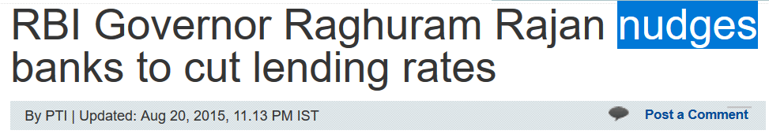
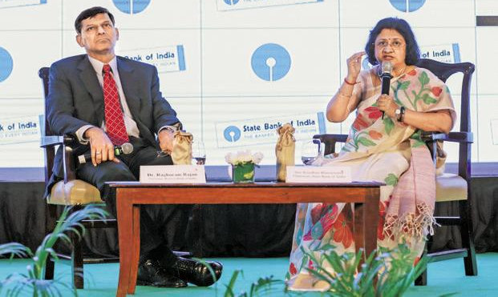
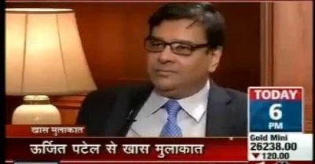
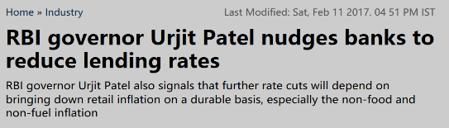
Application of moral suasion[नैतिक दबाव]

Slide 45
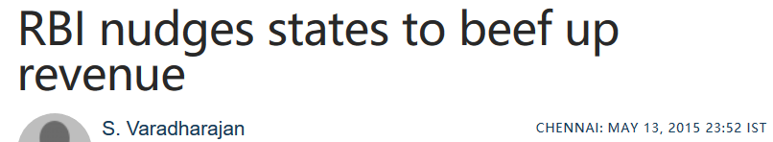
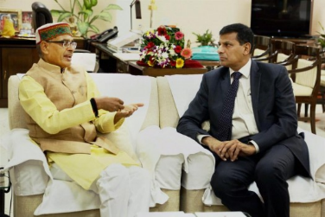
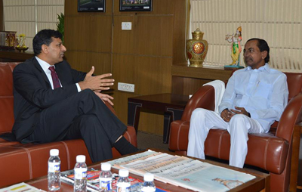
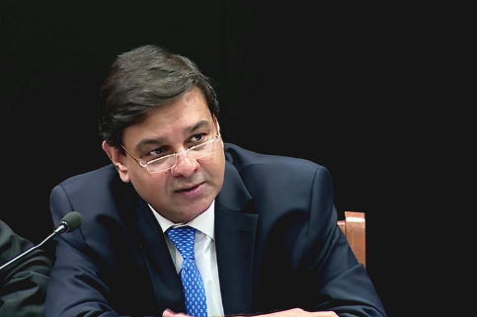
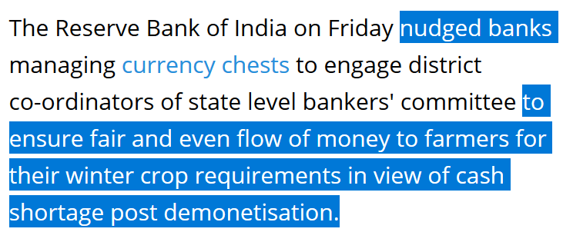
Application of Moral Suasion [नैतिक दबाव]
high Public debt= ▼efficacy of Monetary policy

Slide 46
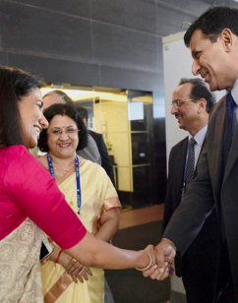
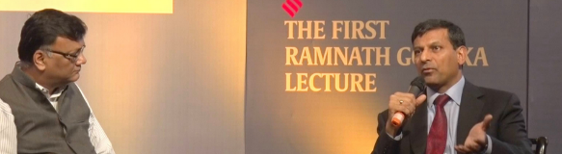
Moral suasion नैतिक दबाव
Qualitative Tools
“Persuasion” without applying “Force”, command/control or monetary incentives.
Via conferences, informal meetings, letters, seminars, convocation, panel discussion, memorial lectures
Asking Banks to transmit rate cuts, Fin.literacy, Give loans to MSE beyond PSL,
Invest in G-Sec beyond SLR to finance govt’s debt….
Asking Government to control fiscal deficit / leakage.

Slide 47
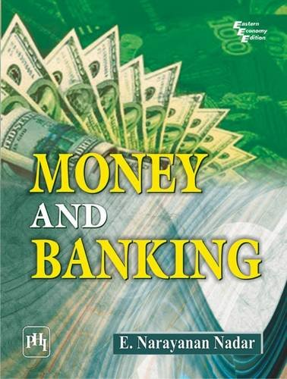
Monetary Policy: Tools
Quantitative/Gen./Indirect
Qualitative: Selective, Direct
Reserve Ratios (CRR, SLR)
Margin / LTV
OMO & MSS
Rates: Bank, MSF, LAF [Repo, RR]
Consumer Credit control / EMI
Selective Credit Control (SCC), PSL, Rationing “ceiling”, Subsidy
Moral Suasion
Direct Action
Asking banks to pass repo-benefit, then isn’t moral suasion a ‘quantitative’ tool?
...baal ki khaal; we’ve to go by books

Slide 48
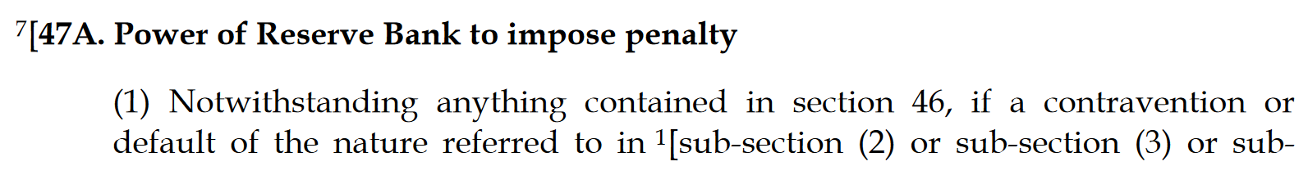
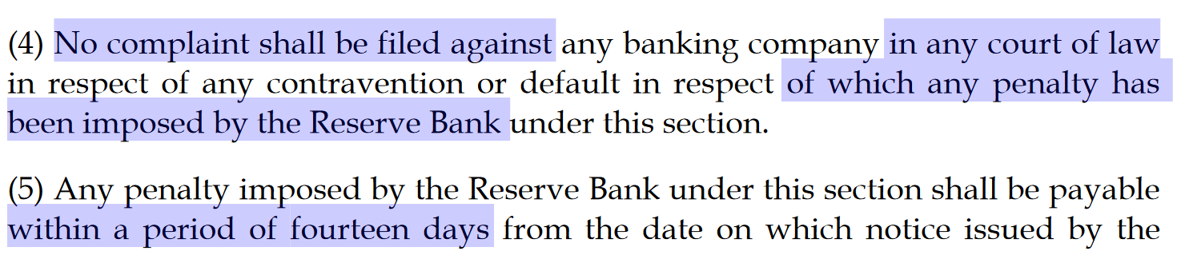
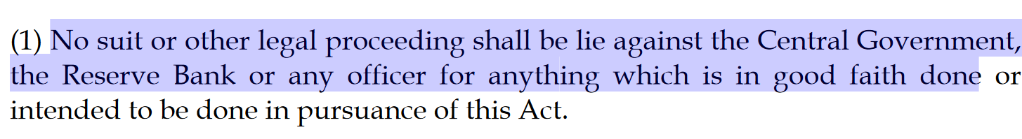
Qualitative Tools ►Direct Action: क्योकि लातो के भुत...
Notes:
Good faith cash withdrawl limits

Slide 49
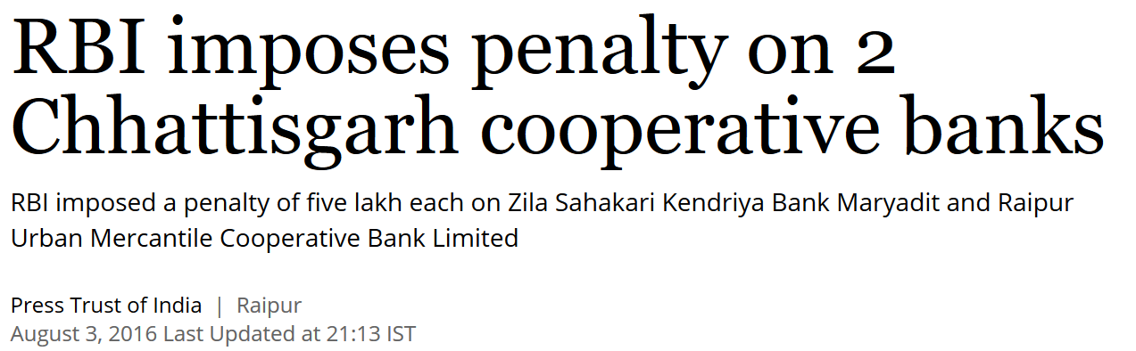
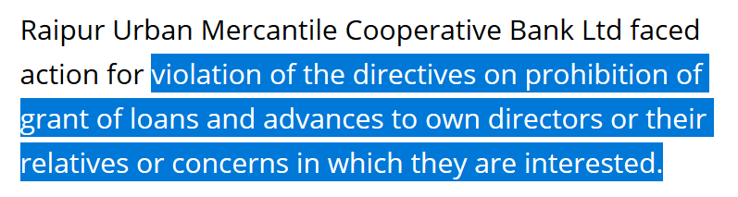
Application

Slide 50
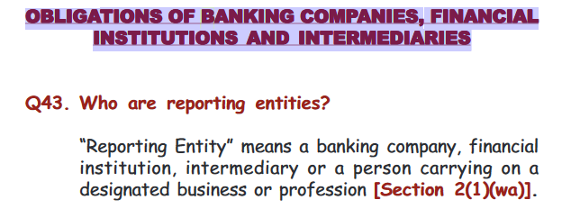
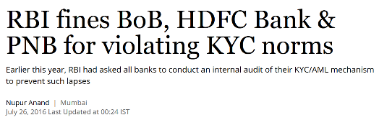
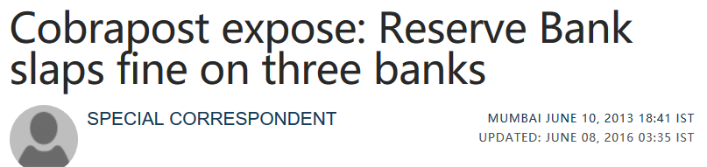
Prevention of money laundering Act 2002

Slide 51

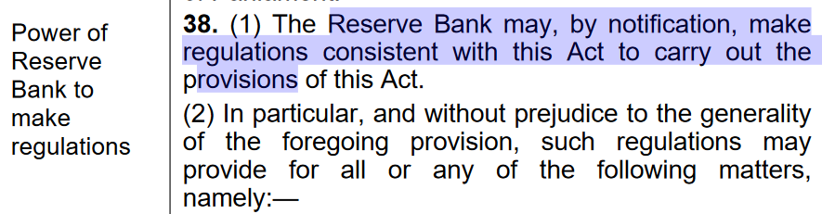
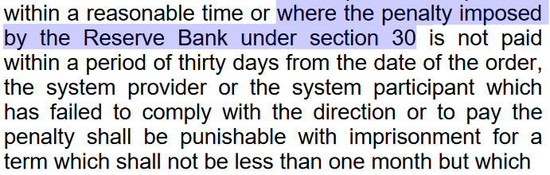
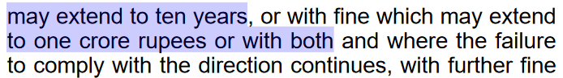
Qualitative Tools ► Direct Action: kyoki laato ke bhoot….

Slide 52
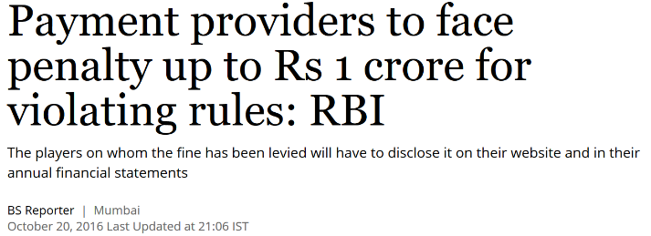
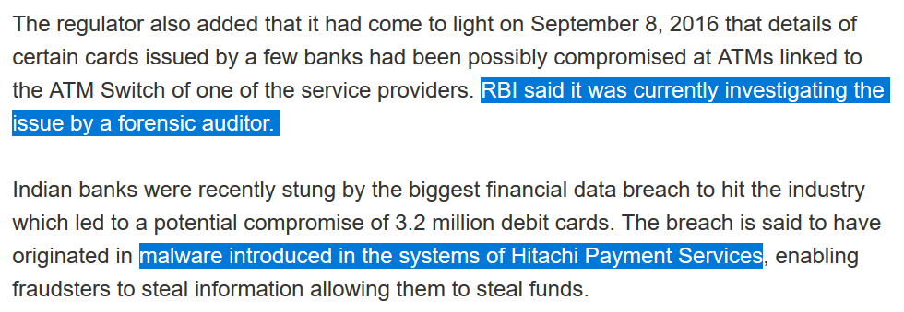
Penalty under Payment & Settlement system Act

Slide 53

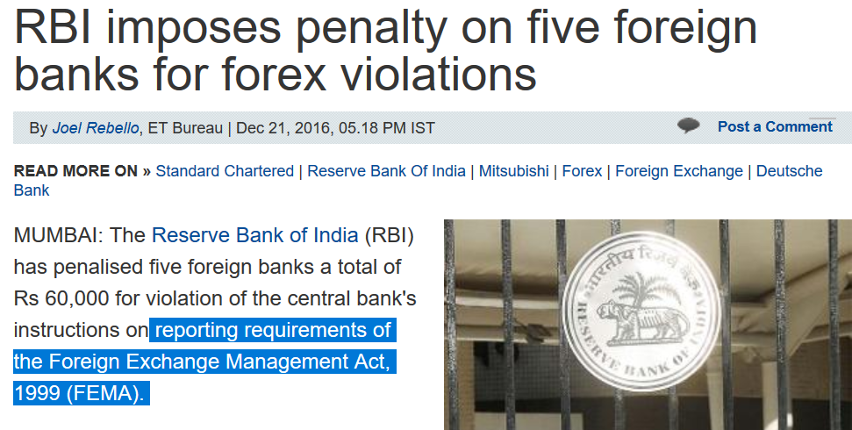
Qualitative Tools ► Direct Action: kyoki laato ke bhoot….

Slide 54
UPSC Prelims 1995
Which of the following is not an instrument of selective credit control?
Regulation of consumer credit
Rationing of credit
Margin requirements
Cash reserve ratio

Slide 55
Monetary Policy: Tools
Volume of credit
Quantitative/Gen./Indirect
Qualitative: Selective, Direct
Reserve Ratios (CRR, SLR)
OMO & MSS
Rates: Bank, MSF, LAF [Repo, RR]
Selective Credit Control (SCC), PSL: Credit Rationing, Subsidy [fiscal policy]
Moral Suasion
Direct Action
+review of last one year’s policies
Consumer Credit control / EMI
Margin / LTV
Distribution of credit
…Limitations of Monetary Policy &
Mains Answer Writing Practice

